Slide 1

Term 3 Project
Customer Analytics
By:
Shubham Rajesh
11th December , 2019

Slide 2
Contents
Overview of the project
Data Description
Problem Statement 1 – Solution
Problem Statement 2 – Solution
Problem Statement 3 – Solution
Problem Statement 4 – Solution

Slide 3
Overview of the project
An International E-Commerce company(Electronic goods) wants to use some of the most advanced machine learning techniques to analyze their customers with respect to their services and some important customer success matrix.
They also have future expansion plans to India.
They have some specific key insights to be found out from their existing customer database.

Slide 4
Data Description
Variable | Description
Id | Id number of the customer.
2. Warehouse_block | The company has a big warehouse which is divided in various blocks such as A,B,C,D and so on.
3. Mode_of_Shipment | The company ships the products by different modes of transport such as ship, air and road.
4. Customer_care_calls | This variable indicates the number of calls made for enquiry of the shipment.
5. Customer_rating | The company has rated every customer on various parameters, 1 being the lowest (Worst), 5 being highest (Best)
6. Cost_of_the_Product | The trade value in US Dollars
7. Prior_purchases | This variable indicates the number of prior purchases

Slide 5
Data Description
Variable | Description
8. Product_importance | The company has categorised the products in the range of high, medium and low based on various parameters
9. Gender | Male Or Female
10. Discount_offered | it is the percentage of discount offered on that specific product.
11. Weight_in_gms | It is the weight in grams
12. Reached.on.Time_Y.N | It is the Y variable, where 1 Indicates that the product has NOT reached on time and 0 indicates it has reached on time.

Slide 6
Problem Statement 1
As a Data Scientist, we need to build a model to predict if the shipments are or will reach on time or not. For this, we need to use various Logic/Probabilistic techniques with the most accurate model. The main models we need to build and compare the accuracy are:
Logistic Regression
Support Vector Machines
Random Forest
XgBoost or any other boosting technique.

Slide 7
Machine Learning Algorithms
Comparative study For Test Data set:
Algorithm | Accuracy | Precision | Recall
Logistic Regression | 65.64 % | 86.13 % | 54.67%
Random Forest | 66.3 % | 74.70 % | 56.20 %
Support Vector Machine | 65.61 % | 74.22 % | 55.49 %
XGBoost | 67.61 % | 84.23 % | 56.51 %

Slide 8
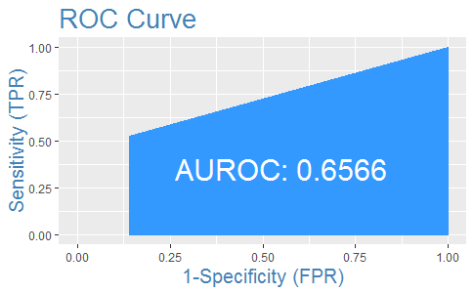

Logistic Regression
XGBoost

Slide 9
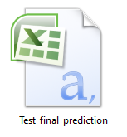
Prediction for test data
Final prediction for test data is done based on the best model.
XGBoost gives better results as compared to other model.
Using XGBoost model prediction is done for test data.
Attched Excel file contain the Prediction Result.

Slide 10
Problem Statement 2
We also need to know, if their shipments are reaching on time to their best customers who have a :
Good customer rating.
Good customer score.
Make recurring orders.
Highest payment buyers

Slide 11
RFM Model Results
Selected those customers for which recency, frequency and monetary score is 4 and 5 based on RFM model.
Customer ID is unique so the frequency score for all customer is 1.
RFM gives 2101 best customers.
Out of 2101 customer, for 1137 customer delivery is reached on time and remaining for 937 customer delivery are not reached on time.

Slide 12
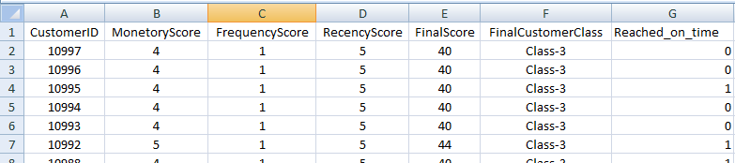
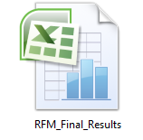
RFM Result Data
Attached Excel file contains the whole customer and their score.

Slide 13
Problem Statement 3
We need to create a customer segmentation using clustering algorithm of the customers to whom the shipments are not reaching on time.
In order to create customer segmentation, I used Cluster Analysis.
Used Calinski criterion for optimum number of cluster and for the cluster segmentation used hierarchical clustering as well as K Means clustering.

Slide 14
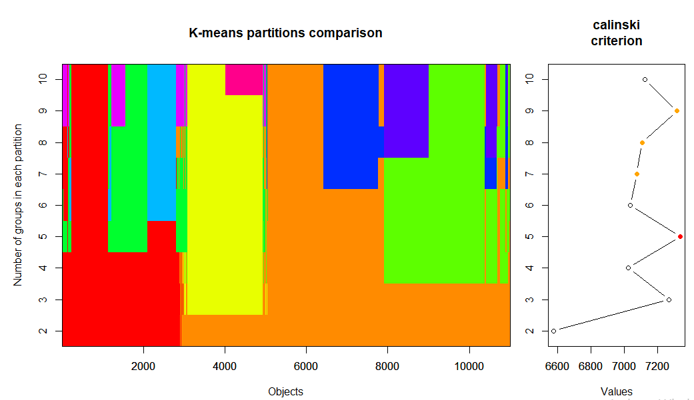
Plotting Clusters using Kmeans and Calinski Criterion

Slide 15
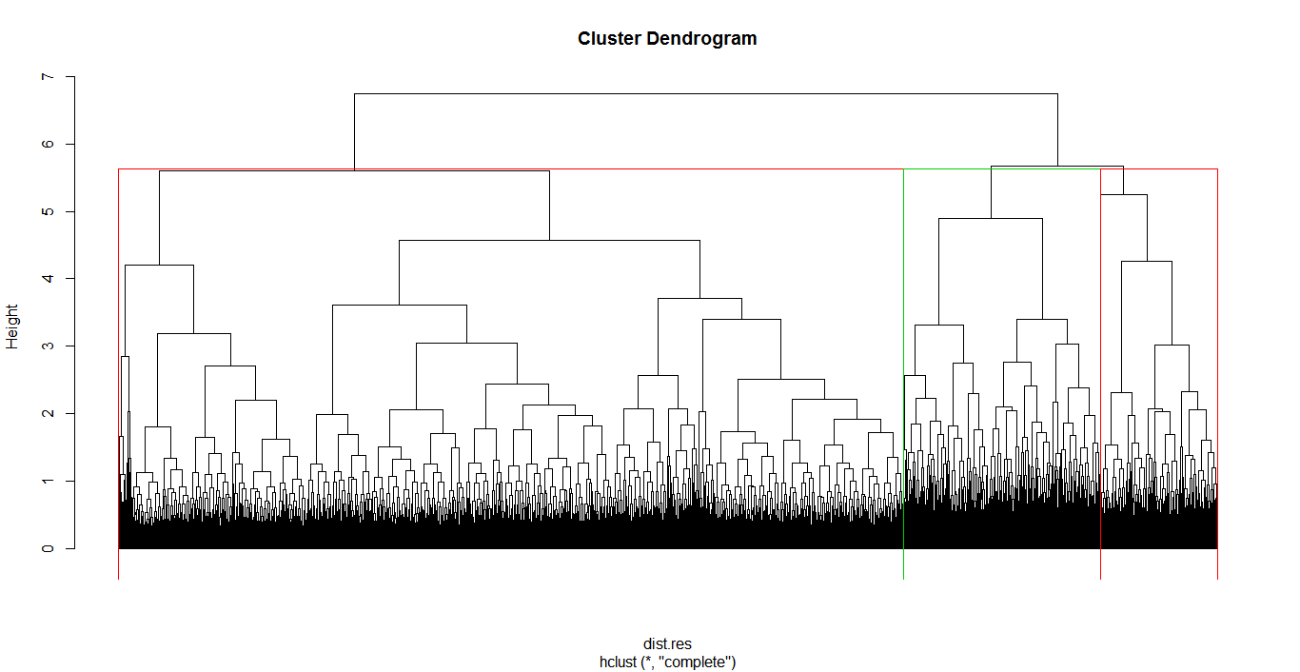
Cluster Visualization:

Slide 16
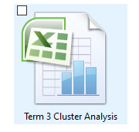
Based on the calinski criterion, five clusters are created.
Attached Excel file contain the Cluster Analysis Result.
Size of the Customers present in different Clusters
Cluster 1 = 2964
Cluster 2 = 1855
Cluster 3 = 3034
Cluster 4 = 1494
Cluster 5 = 1652

Slide 17
Problem Statement 4
Since, the company also wants to start their operations in India, we need to do a Sentiment analysis(Positive or Negative) of company’s competitors such as:
Amazon India
Flipkart
Snapdeal

Slide 18
Steps Performed for Sentiment Analysis:
Create a Twitter developer account.
Fetch real time data.
Data Preprocessing :
a. Removing Special Characters
b. Convert all text to lower case.
c. Replace blank space.
d. Remove punctuation.
e. Remove links, etc.
4. Create a Corpus.
5. Calculate sentiment score.
library("syuzhet")
mysentiment_amazon<-get_nrc_sentiment((amazon_text))
Sentimentscores_amazon<-data.frame(colSums(mysentiment_amazon[,]))

Slide 19
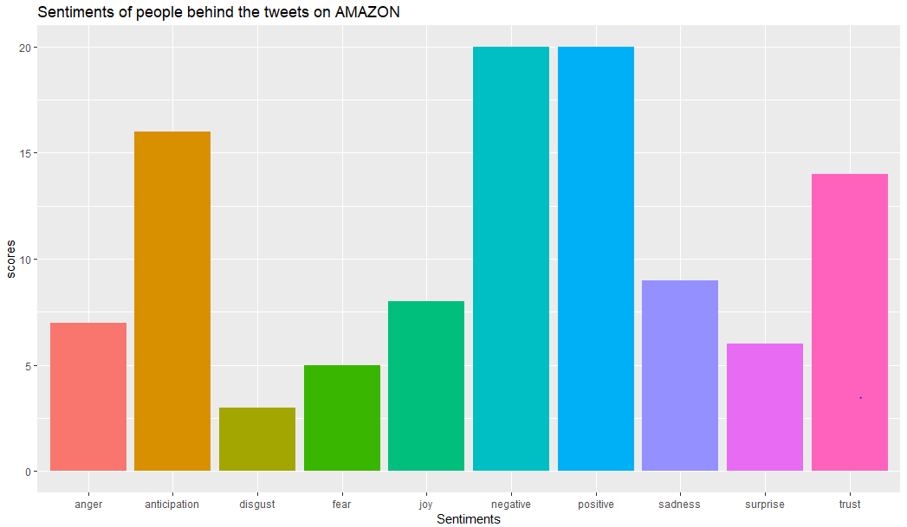
Steps Performed for Sentiment Analysis:
6. Plot the sentiments scores.

Slide 20
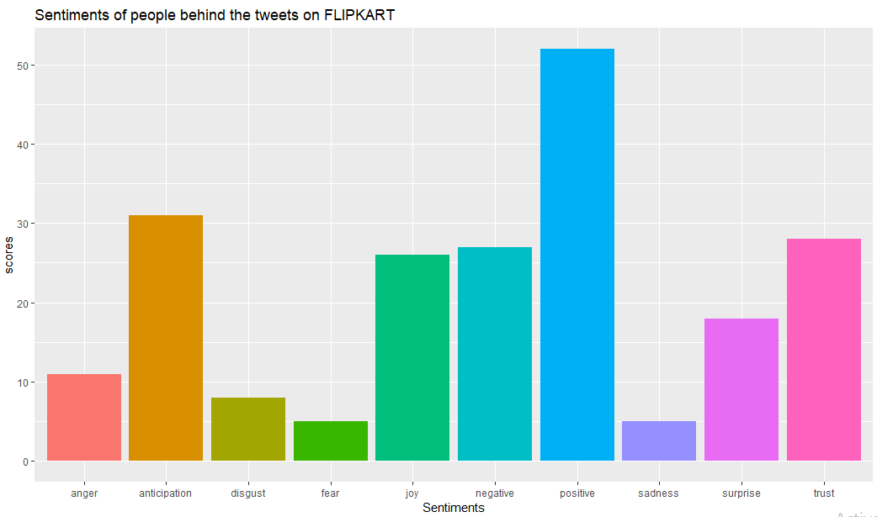

Slide 21
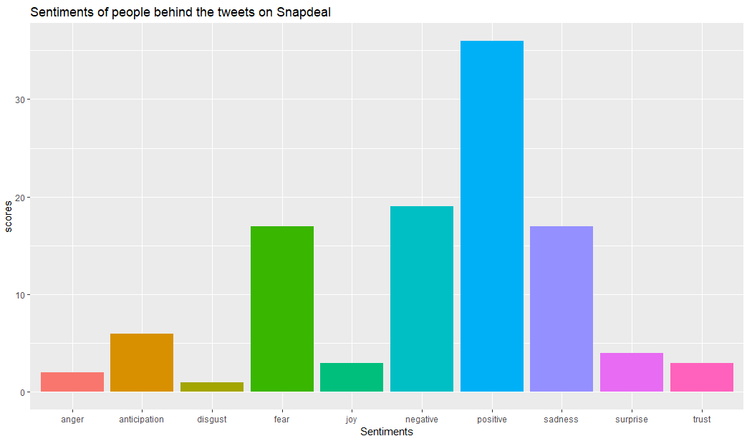

Slide 22
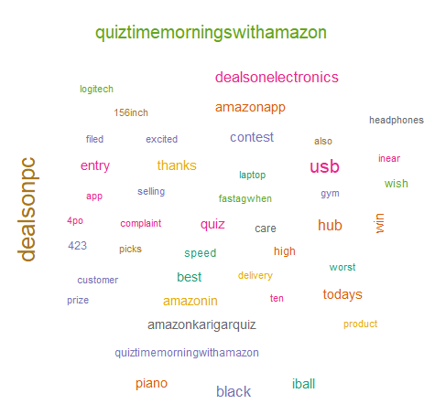
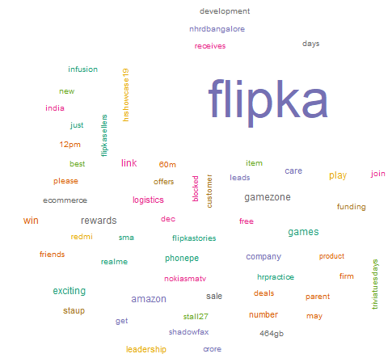
Word Cloud
Amazon Word Cloud
Flipkart Word Cloud

Slide 23
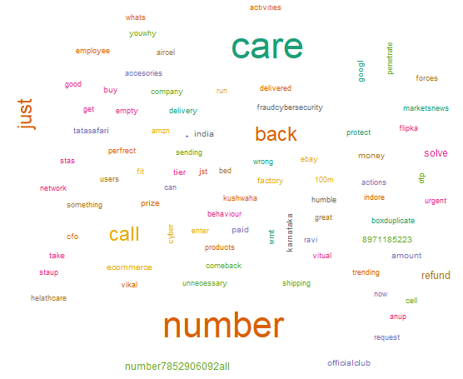
Snapdeal Word Cloud

Slide 24
Thank you!

